Slide 1
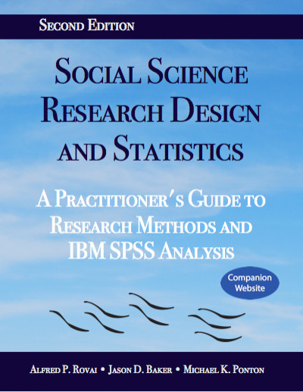
Social Science Research Design and Statistics, 2/e
Alfred P. Rovai, Jason D. Baker, and Michael K. Ponton
Binomial Test
PowerPoint Prepared by
Alfred P. Rovai
IBM® SPSS® Screen Prints Courtesy of International Business Machines Corporation,
© International Business Machines Corporation.

Slide 2
Uses of the Binomial Test
The binomial test is a nonparametric procedure that determines if the proportion of cases in one of two categories is different from a hypothesized test proportion; e.g., different from .5.
Continuous variables can be set up dichotomously with only two values by specifying a cut point where everything less than or equal to the cut point is in the first category and everything above the cut point is in the second category. If there are more than two categories, one should use the chi-square goodness-of fit test.

Slide 3
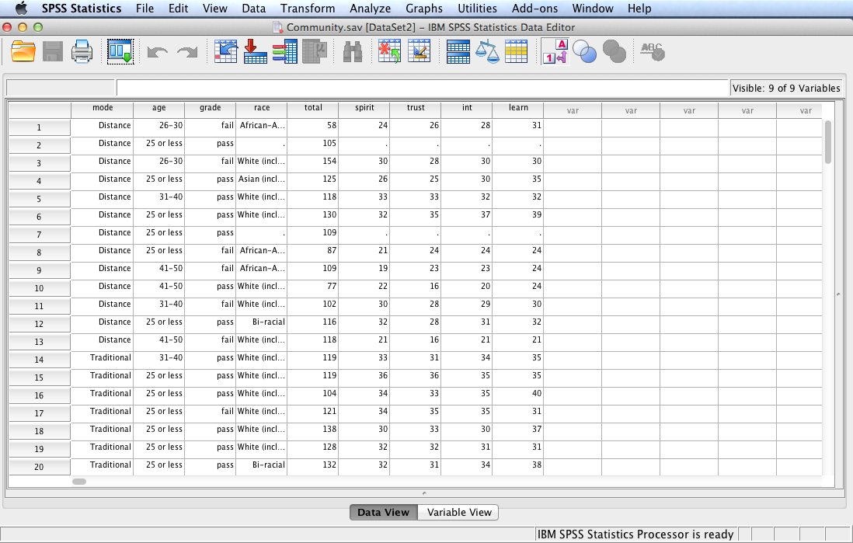
Open the dataset Community.sav.
File available at http://www.watertreepress.com/stats

Slide 4
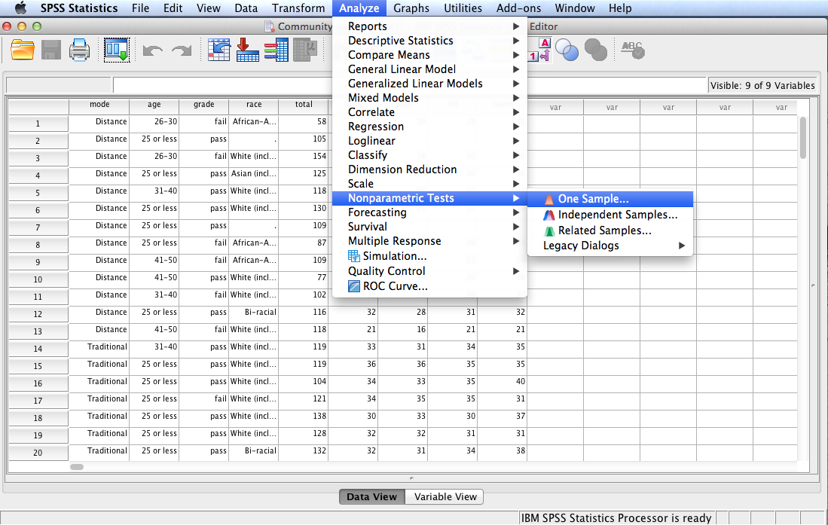
Follow the menu as indicated. A second method, using Legacy Dialogs, can also be used.

Slide 5
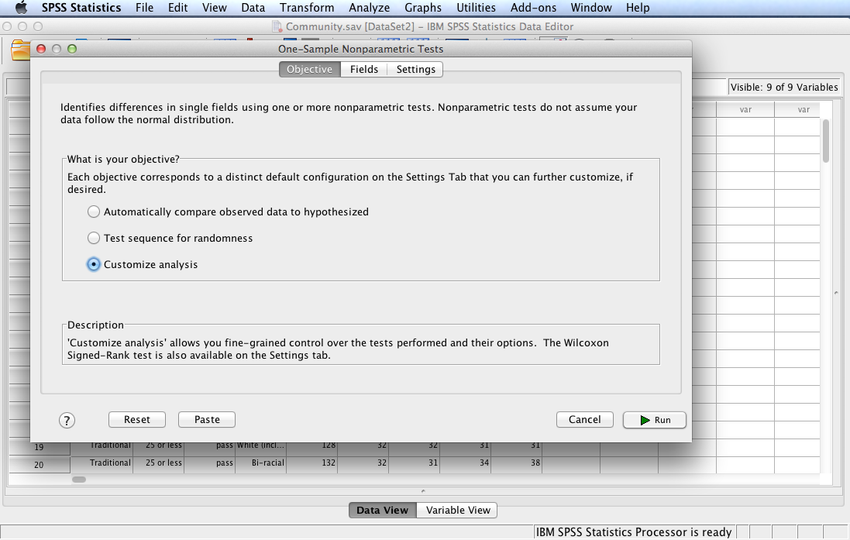
Select Customize analysis then click the Fields tab.

Slide 6
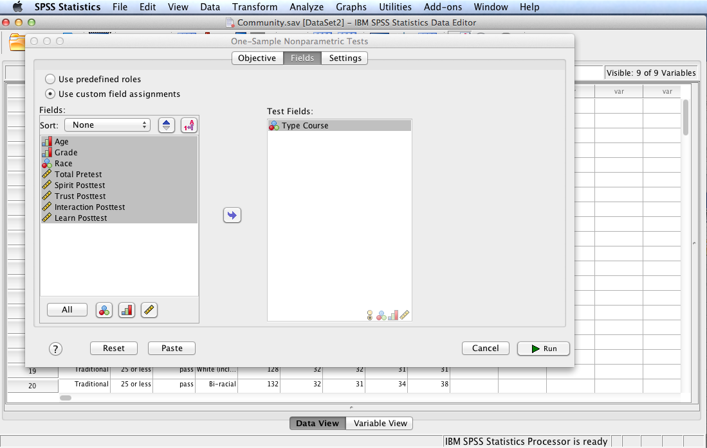
In this example, we will test the following null hypothesis:
H₀: There are no differences in the proportions of college students enrolled in distance online courses and traditional on-campus courses, P = .5.
Move variables so that only Type Course is in the Test Fields: box.
Click the Settings tab.

Slide 7
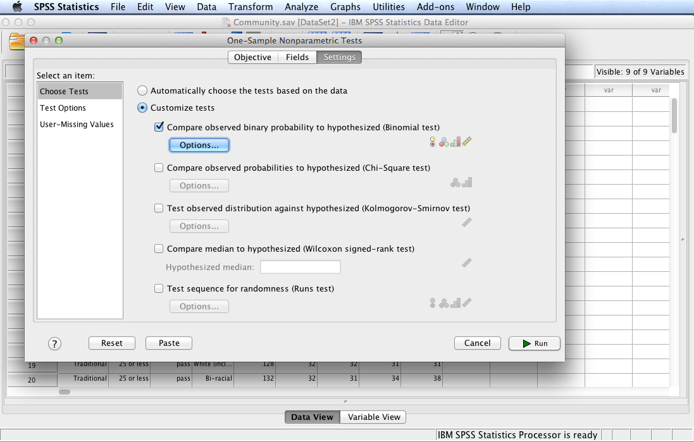
Check Customize tests and Compare observed binary probability to hypothesized (Binomial test).
Click Options.

Slide 8
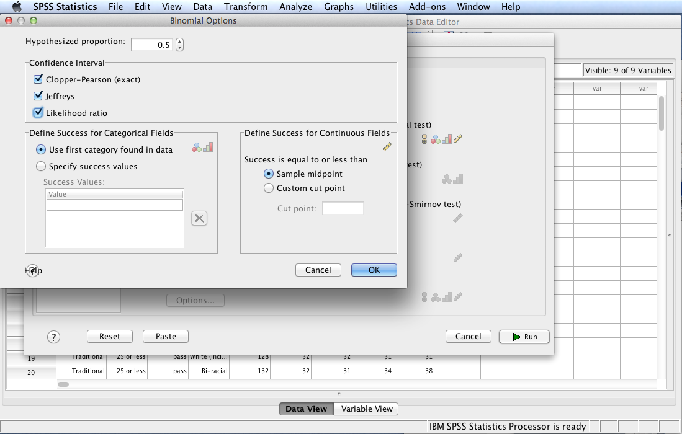
Retain the default hypothesized proportion, P = .5. Select all the Confidence Interval options. Click OK.
Note: Clopper-Pearson (exact) is an exact interval based on the cumulative binomial distribution.
Jeffreys is a Bayesian interval based on the posterior distribution of P using the Jeffreys prior.
Likelihood ratio is an interval based on the likelihood function for P.

Slide 9
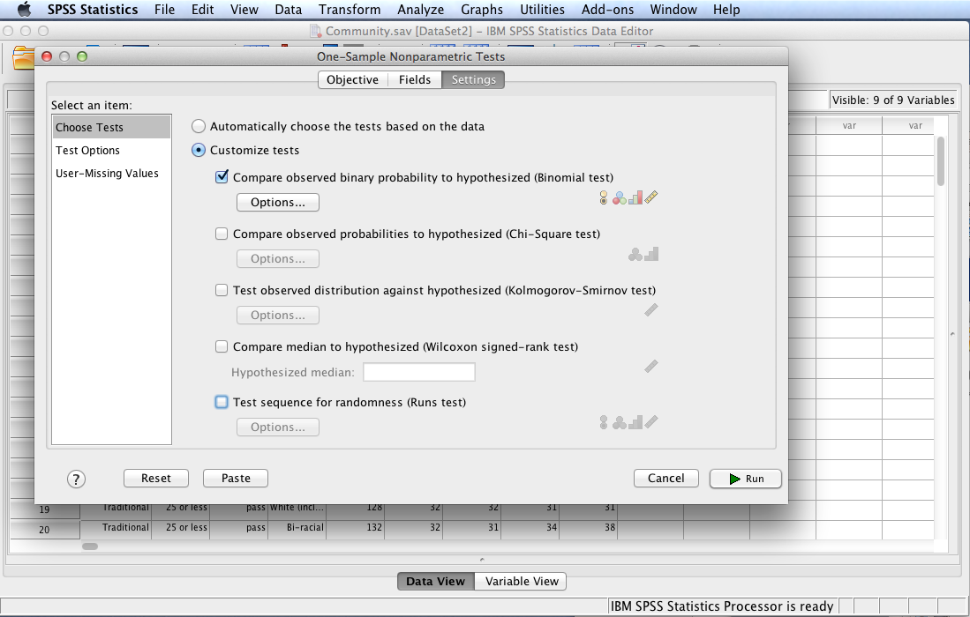
Select Test Options.

Slide 10
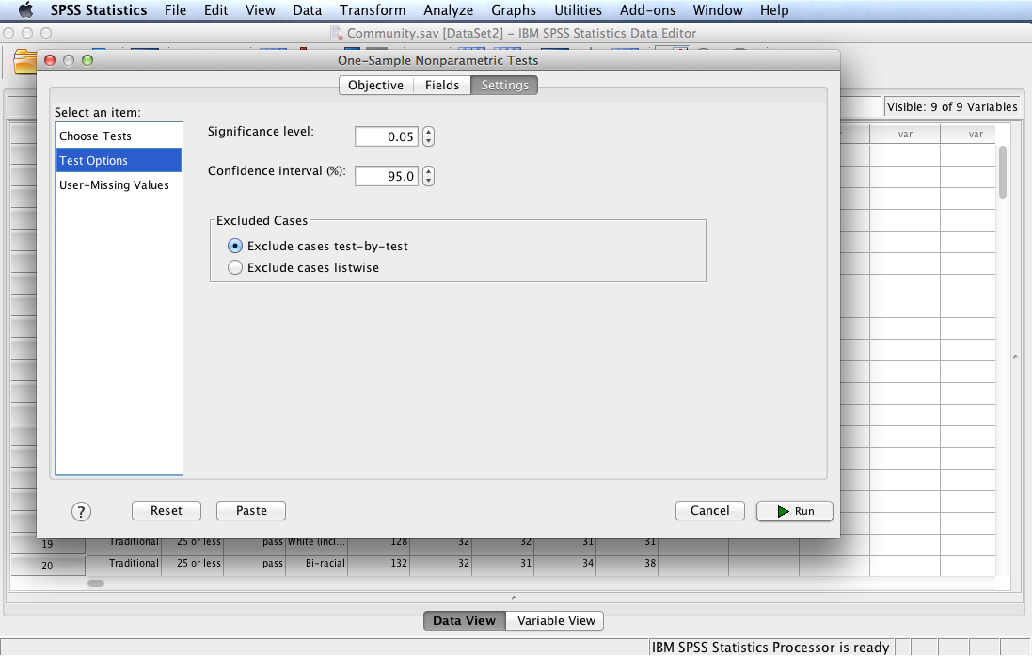
Note defaults. Click Run.

Slide 11
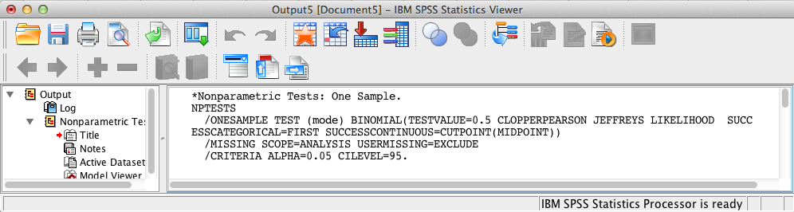
SPSS Output
The contents of the SPSS Log is the first output entry. The Log reflects the syntax used by SPSS to generate the Nonparametric Tests output.

Slide 12
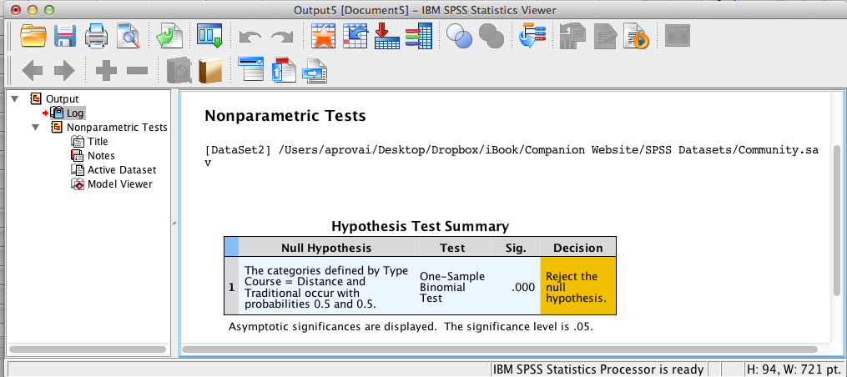
SPSS Output
The above summary table shows that the Binomial test is significant, p < .001, since the significance level <= .05 (the assumed à priori significance level). Double-click the table in the SPSS output window to launch the Model Viewer.

Slide 13
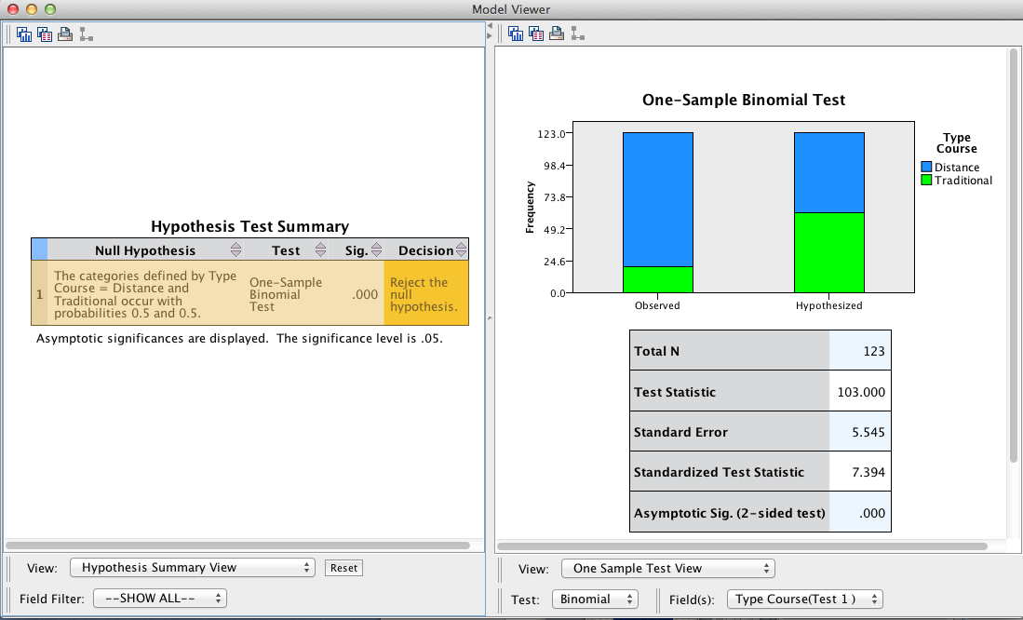
SPSS Output
The Model Viewer displays statistical details using the One-Sample Test View. Select Categorical Field Information from the View: pop-up menu to view a simple bar chart.

Slide 14
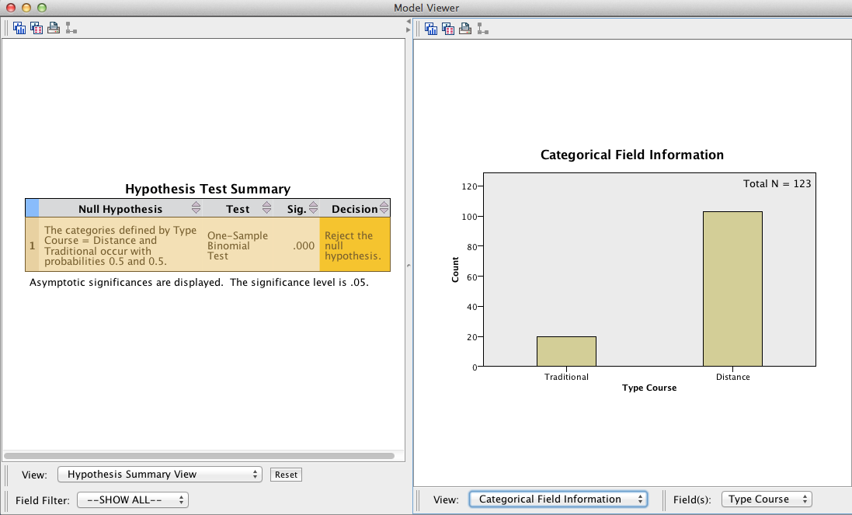
SPSS Output
The Model Viewer displays statistical details using the Categorical Field Information View. Select Confidence Interval Summary View from the View: pop-up menu to view Confidence Interval Statistics.

Slide 15
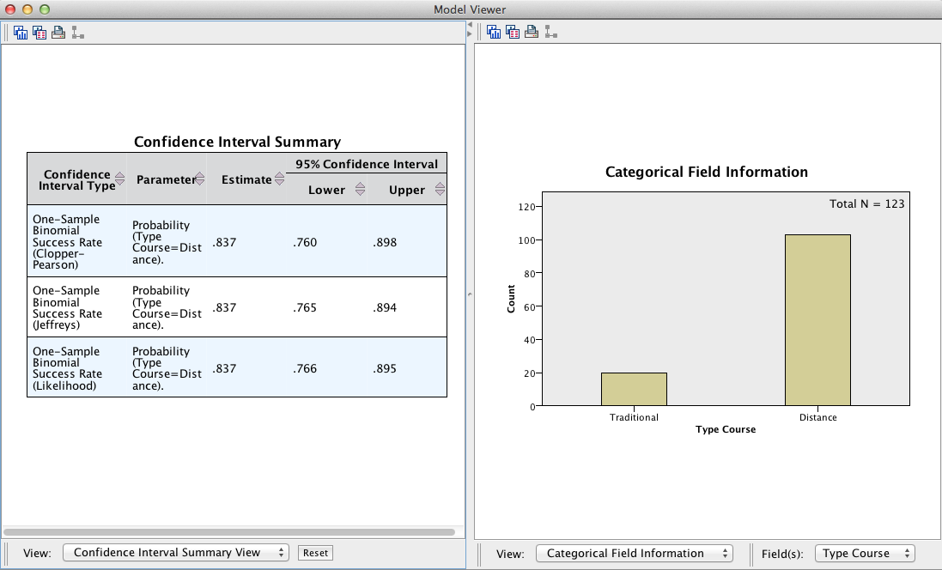
SPSS Output

Slide 16
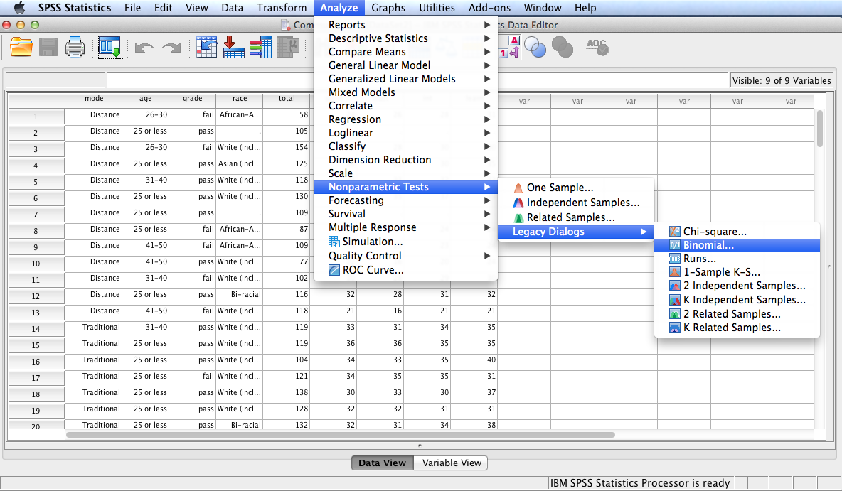
Follow the menu as indicated to run the Binomial test using Legacy Dialogs.

Slide 17
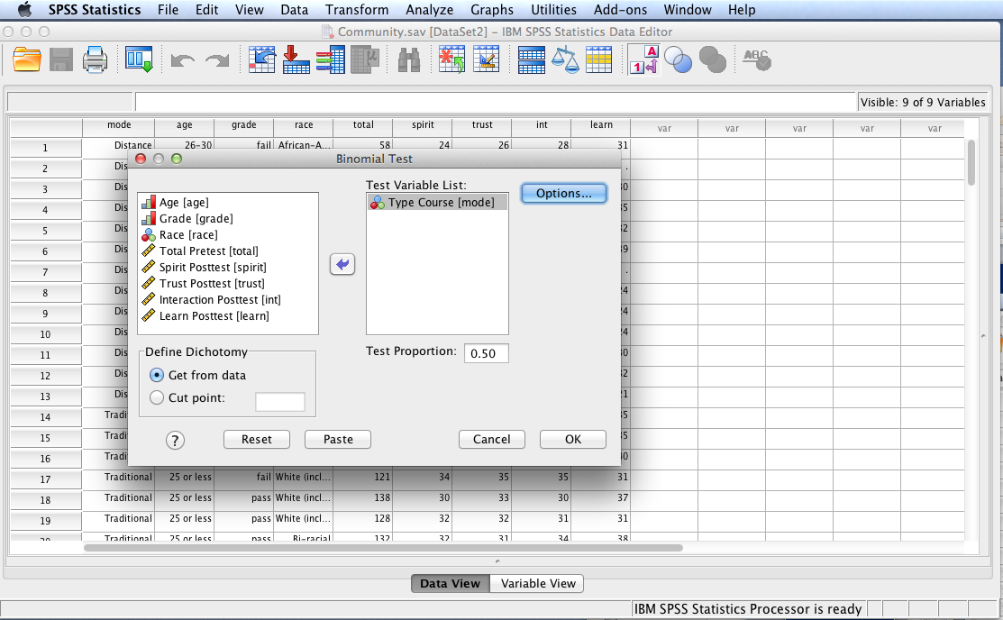
Move Type Course to the Test Variable List: box. Note the Test Proportion is set for 0.50, the desired value. Click Options.

Slide 18
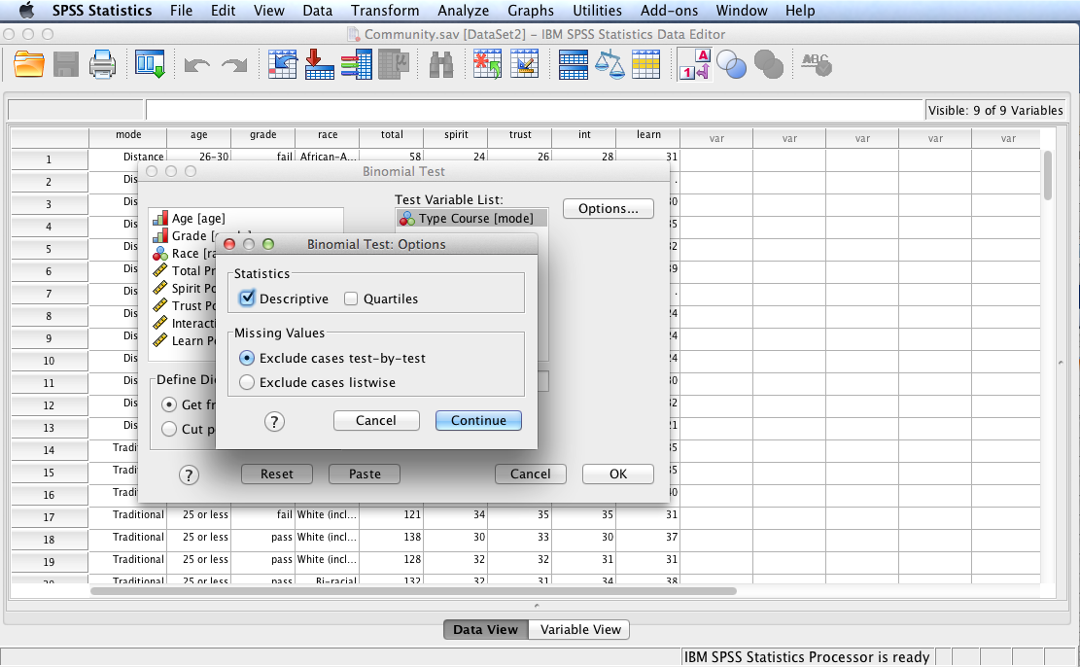
Check Descriptive to generate descriptive statistics. Click Continue and then OK.

Slide 19
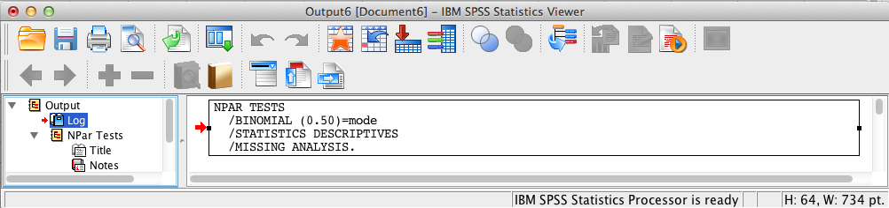
SPSS Output
The contents of the SPSS Log is the first output entry. The Log reflects the syntax used by SPSS to generate the NPar Tests output.

Slide 20
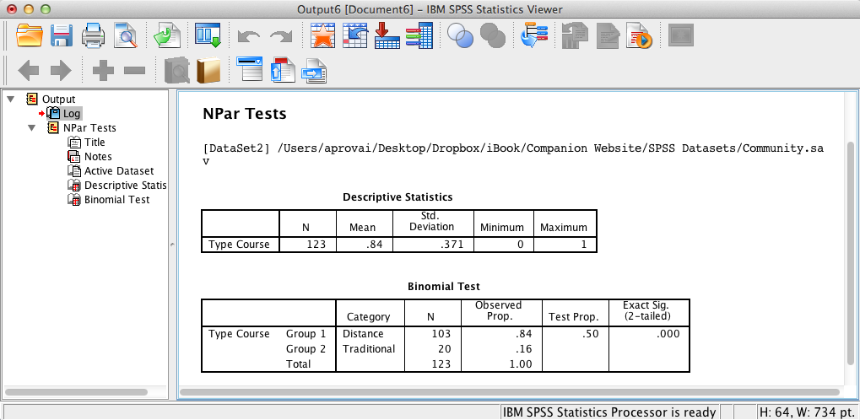
SPSS Output
Descriptive statistics and Binomial test results are also displayed. Npar test results and Nonparametric test results (previously run) are the same (as expected).

Slide 21
Binomial Test Results Summary
H₀: There are no differences in the proportions of college students enrolled in distance online courses and traditional on-campus courses, P = .5. The Binomial test results are significant, z = 7.39, p < .001. Consequently, there is sufficient evidence to reject the null hypothesis and conclude that a significantly greater proportion of college students are enrolled in distance courses than traditional courses in the target population. The 95% confidence interval of the probability of preferring distance online courses over traditional on-campus courses is .76 to .90. Effect size, as a measure of the difference between observed and hypothesized proportions, is .34 (.84 – .50).

Slide 22
End of Presentation

